Slide 1
BIT1213 Operating Systems
Introduction and Overview

Slide 2
Operating System Definition
An operating System (OS) is an intermediary between users and computer hardware. It provides users an environment in which they can execute programs conveniently and efficiently.
In technical terms, It is a software which manages hardware. An operating System controls the allocation of resources and services such as memory, processors, devices and information.
An operating system is a program that acts as an interface between the user and the computer hardware and controls the execution of all kinds of programs.

Slide 3
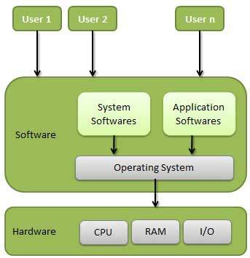
Operating System

Slide 4
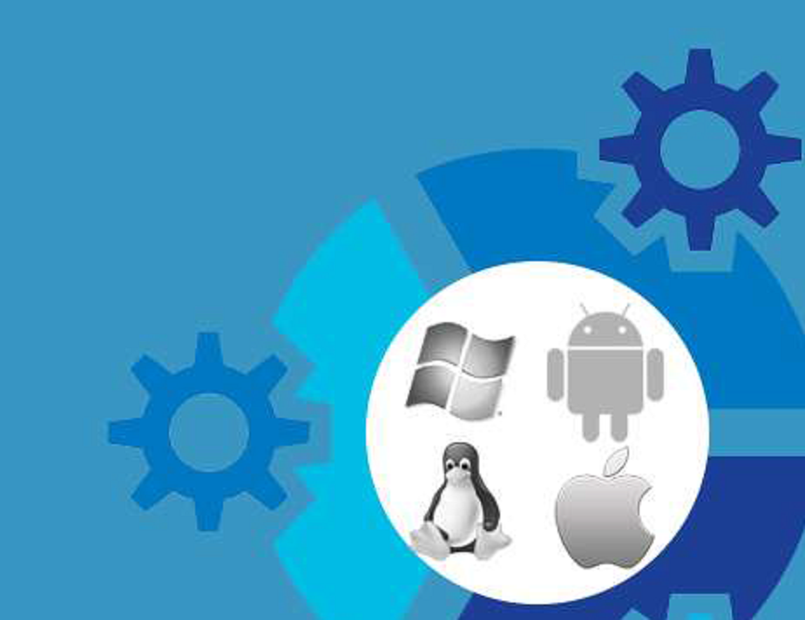
Read about the history of network operating systems

Slide 5
Resource- a component of limited availability necessary for effective operation
Process- is an active program
Deadlock- is a situation in which two or more competing actions are each waiting for the other to finish and thus neither ever does.
Buffer- is a volatile storage area that stores data.
Cache- area of fast memory that stores copies of data
Buffer has the only copy of data while cache usually has another copy while the original copy is stored somewhere in the system and cache memory is faster than buffer.
OS kernel- contains basic functions of that active process all the time.
Core component of the OS that controls everything.
Interrupt- is a change in flow of an execution and modern OSs are interrupt driven.
Volatile storage
Non-volatile storage

Slide 6
Functions of O.S
Memory Management
Processor Management
Device Management
File Management
Security
Control over system performance
Job accounting
Error detecting aids
Coordination between other software and users

Slide 7
Memory Management
Memory management refers to management of Primary Memory or Main Memory.
Main memory is a large array of words or bytes where each word or byte has its own address.
Main memory provides a fast storage that can be accessed directly by the CPU. So for a program to be executed, it must be in the main memory.
Activities of O.S for memory management.
Keeps tracks of primary memory i.e. what part of it are in use by whom, what part are not in use.
In multiprogramming, OS decides which process will get memory when and how much.
Allocates the memory when the process requests it to do so.
De-allocates the memory when the process no longer needs it or has been terminated.

Slide 8
Processor management
In multiprogramming environment, OS decides which process gets the processor when and how much time. This function is called process scheduling.
Activities O. S for processor management.
Keeps tracks of processor and status of process. Program responsible for this task is known as traffic controller.
Allocates the processor(CPU) to a process.
De-allocates processor when processor is no longer required.

Slide 9
Device management
OS manages device communication via their respective drivers. Operating System does the following activities for device management.
Keeps tracks of all devices. Program responsible for this task is known as the I/O controller.
Decides which process gets the device when and for how much time.
Allocates the device in the efficient way.
De-allocates devices.

Slide 10
File management
A file system is normally organized into directories for easy navigation and usage. These directories may contain files and other directions.
Activities of the OS in file management.
Keeps track of information, location, uses, status etc. The collective facilities are often known as file system.
Decides who gets the resources.
Allocates the resources.
De-allocates the resources.

Slide 11
Other activities
Following are some of the important activities that Operating System does.
Security -- By means of password and similar other techniques, preventing unauthorized access to programs and data.
Control over system performance -- Recording delays between request for a service and response from the system.
Job accounting -- Keeping track of time and resources used by various jobs and users.
Error detecting aids -- Production of dumps, traces, error messages and other debugging and error detecting aids.
Coordination between other softwares and users -- Coordination and assignment of compilers, interpreters, assemblers and other software to the various users of the computer systems.

Slide 12
Types of Operating Systems

Slide 13
Batch operating system
The users of batch operating system do not interact with the computer directly. Each user prepares his job on an off-line device like punch cards and submits it to the computer operator. To speed up processing, jobs with similar needs are batched together and run as a group. Thus, the programmers left their programs with the operator. The operator then sorts programs into batches with similar requirements.
The problems with Batch Systems are following.
Lack of interaction between the user and job.
CPU is often idle, because the speeds of the mechanical I/O devices is slower than CPU.
Difficult to provide the desired priority.
*** Read about IBM's MVS Operating system***

Slide 14
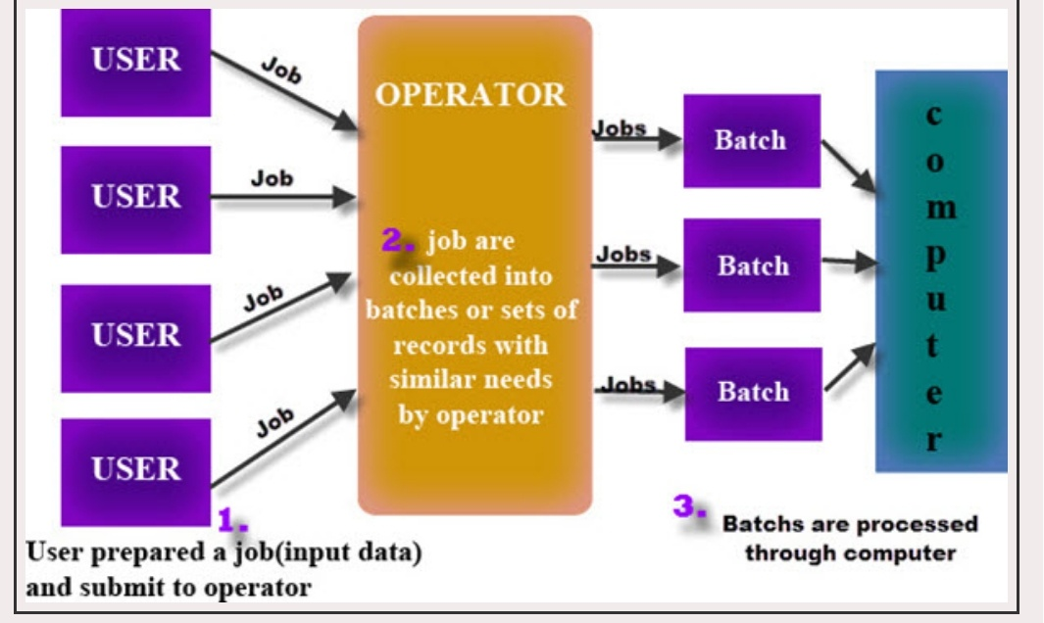

Slide 15
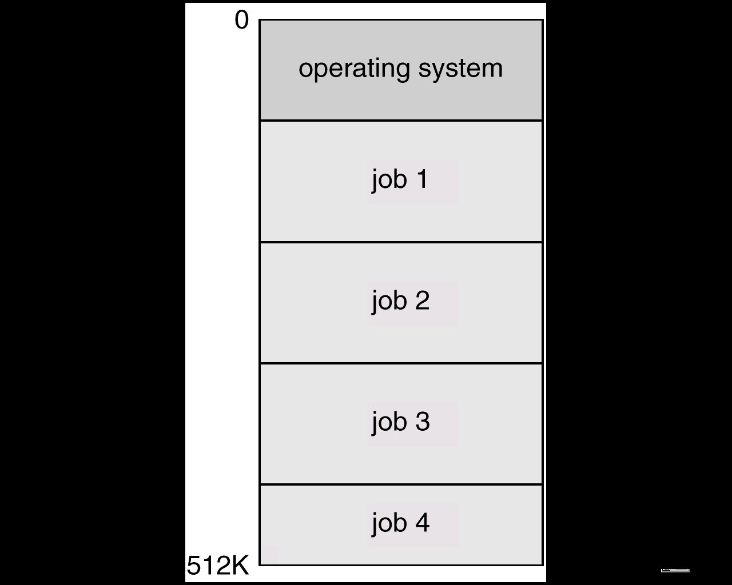
Multiprogrammed Batch Systems
Several jobs are kept in main memory at the same time, and the CPU is multiplexed among them.
As other programs perform input/out, control is taken to another program

Slide 16
OS Features Needed for Multiprogramming
I/O routine supplied by the system.
Memory management – the system must allocate the memory to several jobs.
CPU scheduling – the system must choose among several jobs ready to run.
Allocation of devices.

Slide 17
Time-sharing operating systems
Time sharing is a technique which enables many people, located at various terminals, to use a particular computer system at the same time.
Here processor time is shared among multiple users simultaneously and this is termed as time-sharing. The main difference between Multiprogrammed Batch Systems and Time-Sharing Systems is that in case of Multiprogrammed batch systems, objective is to maximize processor use, whereas in Time-Sharing Systems objective is to minimize response time.
CPU is switched between multiple jobs so as to execute them, the switches occur so frequently thus, the user can receives an immediate response. For example, in a transaction processing, processor execute each user program in a short burst or quantum of computation.
That is if ‘n’ users are present, each user can get time quantum. When the user submits the command, the response time is in few seconds at most.
Operating system uses CPU scheduling and multiprogramming to provide each user with a small portion of a time. Computer systems that were designed primarily as batch systems have been modified to time-sharing systems.

Slide 18
Advantages of timesharing systems
Disadvantages of timesharing systems
Provide advantage of quick response.
Avoids duplication of software.
Reduces CPU idle time.
Problem of reliability.
Question of security and integrity of user programs and data.
Problem of data communication.

Slide 19
Distributed operating System
Distributed systems use multiple central processors to serve multiple real time application and multiple users. Data processing jobs are distributed among the processors accordingly to which one can perform each job most efficiently.
The processors communicate with one another through various communication lines (such as high-speed buses or telephone lines). These are referred as loosely coupled systems or distributed systems. Processors in a distributed system may vary in size and function. These processors are referred as sites, nodes, computers and so on.

Slide 20
The advantages of distributed systems are following.
With resource sharing facility user at one site may be able to use the resources available at another.
Speedup the exchange of data with one another via electronic mail.
If one site fails in a distributed system, the remaining sites can potentially continue operating.
Better service to the customers.
Reduction of the load on the host computer.
Reduction of delays in data processing.

Slide 21
Network operating System
Network Operating System runs on a server and provides server the capability to manage data, users, groups, security, applications, and other networking functions.
The primary purpose of the network operating system is to allow shared file and printer access among multiple computers o n a network, typically a local area network (LAN), a private network or to other networks.
Examples of network operating systems are Microsoft Windows Server 2003, Microsoft Windows Server 2008, UNIX, Linux, Mac OS X, Novell NetWare, and BSD.

Slide 22
The advantages of network operating systems are following.
Centralized servers are highly stable.
Security is server managed.
Upgrades to new technologies and hardware can be easily integrated into the system.
Remote access to servers is possible from different locations and types of systems.
The disadvantages of network operating systems are following.
High cost of buying and running a server.
Dependency on a central location for most operations.
Regular maintenance and updates are required.

Slide 23
Real Time operating System
A real-time operating system (RTOS) is an operating system (OS) intended to serve real-time applications that process data as it comes in, typically without buffer delays. Real-time systems are used when there are rigid time requirements on the operation of a processor
In RTOS there is a little swapping of programs between primary and secondary memory. Most of the time, processes remain in primary memory in order to provide quick response, therefore, memory management in real time system is less demanding compared to other systems
Real-time operating system is characterized by well-defined, fixed time constraints otherwise system will fail.
For example Scientific experiments, medical imaging systems, industrial control systems, weapon systems, robots, and home-appliance controllers, Air traffic control system etc.
A measurement from a petroleum refinery indicating that temperature is getting too high and might demand for immediate attention to avoid an explosion.

Slide 24
Types of real-time operating systems
Hard real-time systems
Hard real-time systems guarantee that critical tasks complete on time. In hard real-time systems secondary storage is limited or missing with data stored in ROM. In these systems virtual memory is almost never found.
Soft real-time systems
Soft real time systems are less restrictive. Critical real-time task gets priority over other tasks and retains the priority until it completes.
Soft real-time systems have limited utility than hard real-time systems. For example, Multimedia, virtual reality, Advanced Scientific Projects like undersea exploration and planetary rovers etc.

Slide 25
Parallel Systems
Multiprocessor systems with more than one CPU in close communication.
Tightly coupled system – processors share memory and a clock; communication usually takes place through the shared memory.
Advantages of parallel system:
Increased throughput
Economical
Increased reliability

Slide 26
Parallel Systems (Cont.)
Symmetric multiprocessing (SMP)
Each processor runs an identical copy of the operating system.
Many processes can run at once without performance deterioration.
Most modern operating systems support SMP
Asymmetric multiprocessing
Each processor is assigned a specific task; master processor schedules and allocates work to slave processors.
More common in extremely large systems

Slide 27
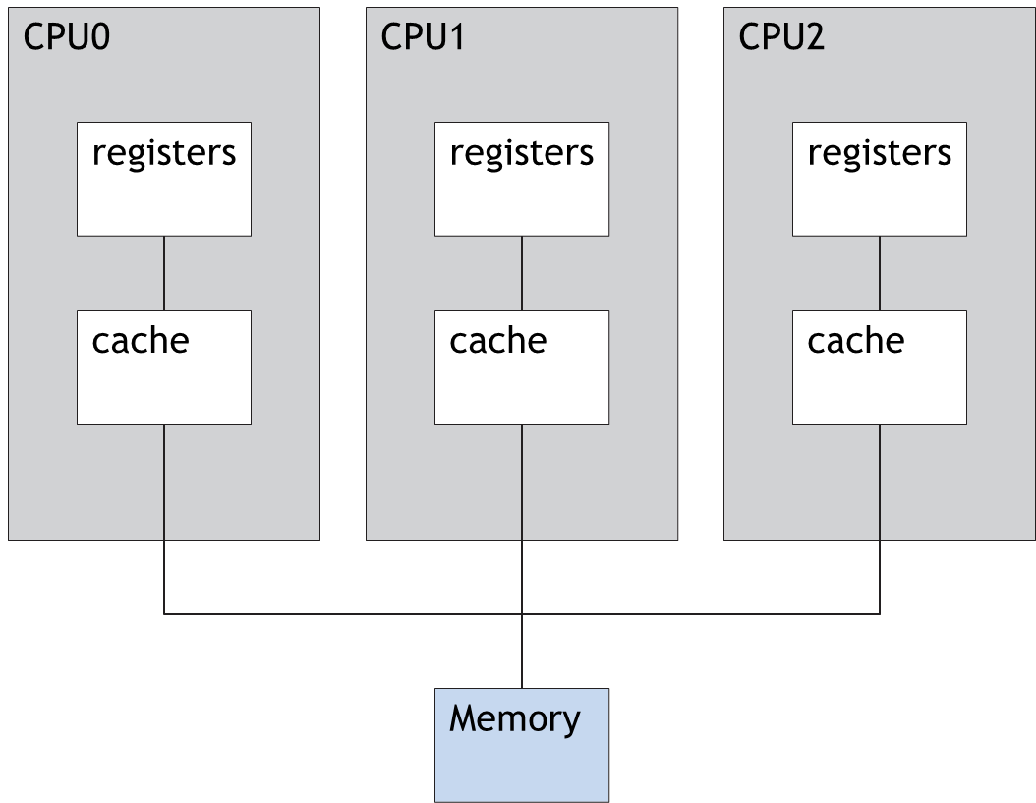
Symmetric Multiprocessing Architecture

Slide 28
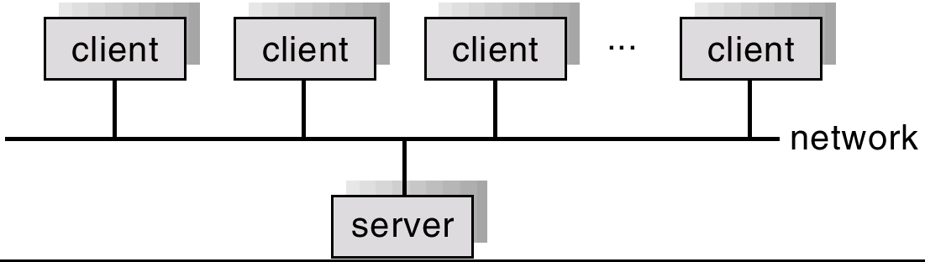
General Structure of Client-Server

Slide 29
Clustered Systems
Clustering allows two or more systems to share storage.
Provides high reliability.
Asymmetric clustering: one server runs the application while other servers standby.
Symmetric clustering: all N hosts are running the application.

Slide 30
Handheld Systems
Personal Digital Assistants (PDAs)
Cellular telephones
Issues:
Limited memory
Slow processors
Small display screens.

Slide 31
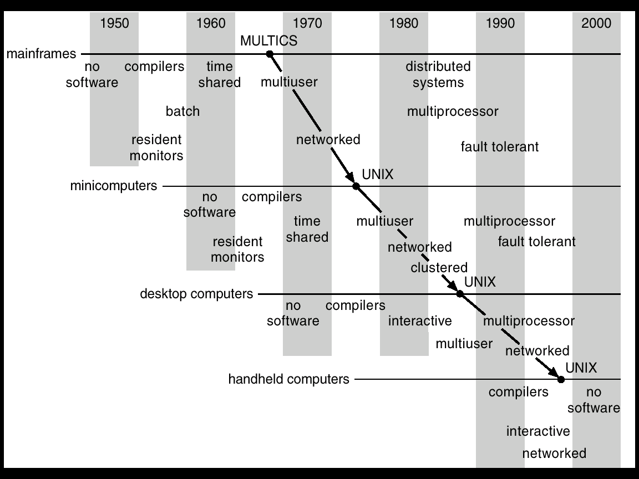
Migration of Operating-System Concepts and Features

Slide 32
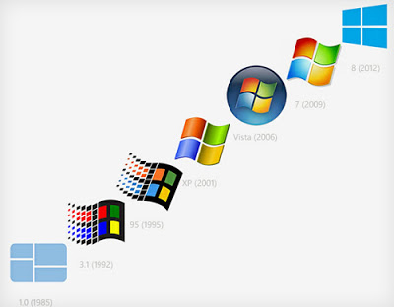
Windows Evolution

Slide 33
Homework
What are the three main purposes of an operating system?
An extreme method of spooling, known as staging a tape, is to read the entire contents of a magnetic tape onto disk before using it. Discuss the main advantage of such a scheme.
In a multiprogramming and time-sharing environment, several users share the system simultaneously. This situation can result in various security problems. a) What are two such problems? b) Can we ensure the same degree of security in a time-shared machine as we have in a dedicated machine? Explain your answer.
What is the main advantage of multiprogramming?
What are the main differences between operating systems for mainframe computers and personal computers?

Slide 34
Homework
Define the essential properties of the following types of operating systems: a. Batch, b. Interactive, c. Time sharing, d. Real time, e. Distributed
We have stressed the need for an operating system to make efficient use of the computing hardware. When is it appropriate for the operating system to forsake this principle and to “waste” resources? Why is such a system not really wasteful?
Under what circumstances would a user be better off using a time-sharing system, rather than a personal computer or single-user workstation?
Why are distributed systems desirable?
What is the main difficulty that a programmer must overcome in writing an operating system for a real-time environment?
What is the purpose of the “resident monitor”? To perform orderly and efficient automatic job sequencing, regardless of errors that might arise.
What were control cards used for? To let monitor know what resources are needed for current job, such as compiler, linker, data, etc., when to use them, and with which file; and to tell monitor when it reaches end of job.

